Slide 1
Natural Language Processing
Dr. Vijayalakshmi Anand
BITS-Pilani
vijayalakshmi_anand@pilani.bits-pilani.ac.in

Slide 2
Session 1
These slides are prepared by the instructor, with grateful acknowledgement of James Allen and many others who made their course materials freely available online.

Slide 3
Agenda
Objective of course
What will we learn in this course?
Text books and Reference books
Evaluation Plan
What is Natural Language Processing?
Application areas of Natural Language Processing
Introduction to Natural Language Processing

Slide 4

Objective of course
To Identify and recall fundamental concepts and techniques in Natural Language Processing (NLP).
To Explain the computational properties of natural languages and articulate the algorithms commonly utilized for processing linguistic information.
To Apply basic mathematical models and methods in NLP applications to solve problems and perform tasks.
To Examine research and development efforts in Natural Language Processing to discern trends, challenges, and opportunities.
26 April 2026

Slide 6
What you will learn in this course
Vector Semantics
Word Embedding
Language Modelling
N-gram language modeling
Neural Language Models
Introduction to LLM and Prompt Engineering
Part-of-Speech Tagging
Parsing
Encoder-Decoder Models, Attention and Contextual Embedding's, BERT
Word sense disambiguation
Semantic web ontology and knowledge Graphs
Retrieval Augmented Generation (RAG)

Slide 7
Text books and Reference books
T1 | Jurafsky and Martin, SPEECH and LANGUAGE PROCESSING: An Introduction to Natural Language Processing, Computational Linguistics, and Speech Recognition, McGraw Hill
T2 | Manning and Schütze, Foundations of Statistical Natural Language Processing, MIT Press. Cambridge, MA
R1 | Allen James, Natural Language Understanding
R2 | Neural Machine Translation by Philipp Koehn
R3 | Semantic Web Primer (Information Systems) By Antoniou, Grigoris; Van Harmelen, Frank

Slide 8
Evaluation Plan
Code | Name | Weight | Date
EC1 | Quiz1 | 5% [Best of 2] | 24 May 2026 to 29 May 2026
 | Quiz2 |  | 26 July 2026 to 1st August 2026
 | EL Assignment I | 12% | 23 May 2026 to 15 June 2026
 | EL Assignment II | 13% | 1st Aug to 31st Aug
EC2 | Midsem Exam [Regular, Make-Up] | 30% | 20-06-2026 (FN) 27-06-2026 (FN)
EC3 | Comprehensive Exam [Regular, Make-Up] | 40% | 05-09-2026 (FN) 12-09-2026 (FN)

Slide 9
What is Natural Language Processing?
Analyze, understand and generate human languages just like humans do.
To explain linguistic theories, to use the theories to build systems that can be of social use..
Started off as a branch of Artificial Intelligence..
Borrows from Linguistics, Psycholinguistics, Cognitive Science & Statistics.
Make computers learn our language rather than we learn theirs.

Slide 10
Why study NLP
A hallmark of human intelligence.
Text is the largest repository of human knowledge and is growing quickly.
emails, news articles, web pages, IM, scientific articles, insurance claims, customer complaint letters, transcripts of phone calls, technical documents, government documents, patent portfolios, court decisions, contracts, ……
The Natural Language Processing (NLP) Market size to grow from USD 15.7 billion in 2022 to USD 49.4 billion by 2027, at a Compound Annual Growth Rate (CAGR) of 25.7% during the forecast period.

Slide 11
Why are language technologies needed?
Many companies make a lot of money if they could use computer programmes that understood text or speech.
answering the phone, and replying to a question
understanding the text on a Web page to decide who it might be of interest to
translating a daily newspaper from Japanese to English
understanding text in journals / books and building an expert systems based on that understanding

Slide 12
Dreams or reality??
Will my computer talk to me like another human ??
Will the search engine get me exactly what I am looking for??
Can my PC read the whole newspaper and tell me the important news only..??
Can my palmtop translate what that Japanese lady is telling me.. ??
Ahhh.. Can my PC do my NLP assignments ??
Do you know how our brain processes language ??

Slide 13
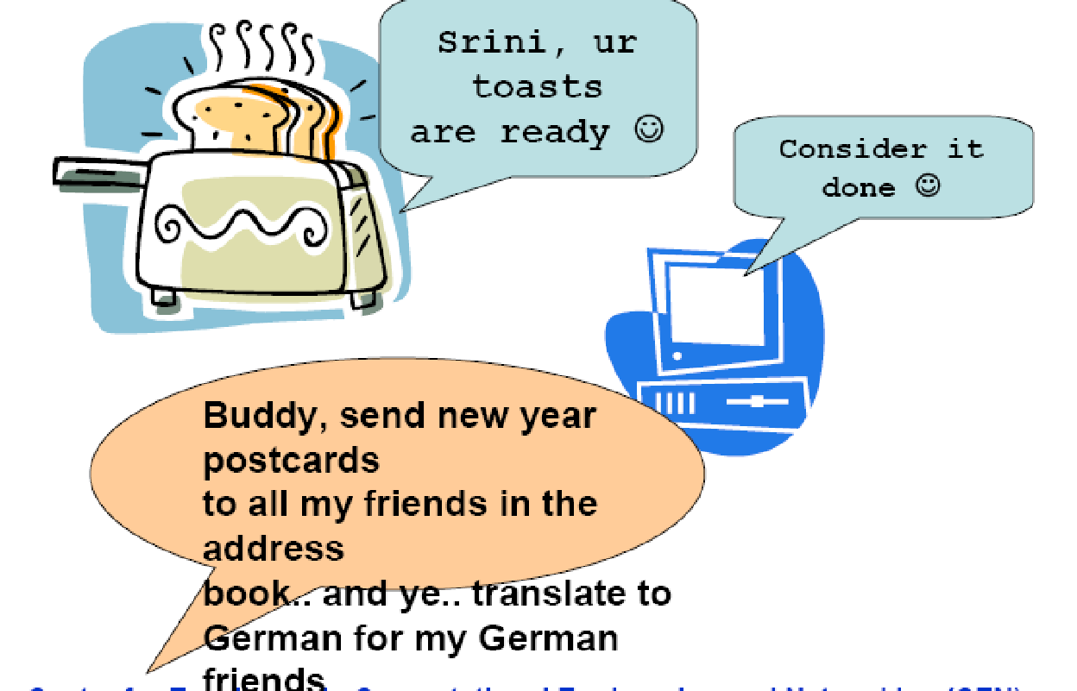
Dream come true?

Slide 14
Where does it fit in the CS taxonomy?
Computers
Databases
Artificial Intelligence
Algorithms
Networking
Robotics
Natural Language Processing
Search
Information
Retrieval
Machine
Translation
Language
Analysis
Semantics
Parsing

Slide 15
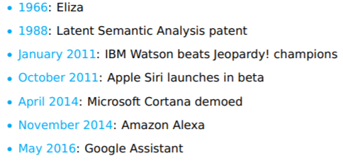
Brief history of NLP
2020 – Conversational Agents

Slide 16
Introduction to Natural Language Processing
The Study of Language.
Applications of Natural Language Understanding.
Evaluating Language Understanding Systems.
The Different Levels of Language Analysis.
Representations and Understanding.
The Organization of Natural Language Processing Systems.

Slide 17
The study of language
Discipline | Typical Problems | Tools
Linguists | How do words form phrases and sentences? What constrains the possible meanings for a sentence? | Intuitions about well-formedness and meaning; mathematical models of structure and meaning
Psycholinguists | How do people identify the structure of sentences? How are word and text meanings identified? | Experimental techniques based on measuring human performance; statistical analysis of observations
Philosophers | What is meaning, and how do words and sentences acquire it? How do words identify objects in the world? | Natural language argumentation using intuition about counter-examples; mathematical models (for example, logic and model theory)
Computational Linguists | How is the structure of sentences identified? How can knowledge and reasoning be modeled? How can language be used to accomplish specific tasks? | Algorithms, data structures; formal models of representation and reasoning; AI techniques (search and representation methods)

Slide 18
Dave: Open the pod bay doors, HAL.
HAL: I am sorry, Dave. I am afraid I can’t do that.
Dave: What’s the problem.
HAL: I think you know what the problem is just as well as I do.
Dave: I don’t know what you’re talking about.
HAL: I know that you and Frank were planning to disconnect
me, and I’m afraid that’s something I cannot allow to happen.
General speech and language understanding and generation capabilities
Politeness: emotional intelligence
Self-awareness: a model of self, including goals and plans
Belief ascription: modeling others; reasoning about their
goals and plans

Slide 19
Hal: I can tell from the tone of your voice, Dave, that you’re upset.
Why don’t you take a stress pill and get some rest.
[Dave has just drawn another sketch of Dr. Hunter].
HAL: Can you hold it a bit closer?
[Dave does so].
HAL: That’s Dr. Hunter, isn’t it?
Dave: Yes.
Recognition of emotion from speech
Vision capability including visual recognition of emotions and faces
Also: situational ambiguity

Slide 20
To attain the levels of performance we attribute to HAL, we need to be able to define, model, acquire and
manipulate
Knowledge of the world and of agents in it,
Text meaning,
Intention

Slide 21
NLP Applications
Question answering
Who is the first Taiwanese president?
Text Categorization/Routing
e.g., customer e-mails.
Text Mining
Find everything that can be done with NLP
Machine (Assisted) Translation
Language Teaching/Learning
Usage checking
Spelling correction
Is that just dictionary lookup?

Slide 22
Application areas
Text-to-Speech & Speech recognition
Healthcare
Natural Language Dialogue Interfaces to Databases
Information Retrieval_
Information Extraction (http://nlp.stanford.edu:8080/ner/process)
Document Classification
Document Image Analysis
Automatic Summarization (https://quillbot.com/summarize)
Text Proof-reading – Spelling & Grammar_
Machine Translation_
Fake News and Cyberbullying Detection
Monitoring Social Media Using NLP
Plagiarism detection
Look-ahead typing / Word prediction_
Question Answering System (http://start.csail.mit.edu/index.php)
Sentiment Analysis (https://komprehend.io/sentiment-analysis)

Slide 23
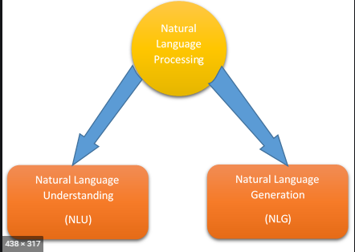
Main components of NLP

Slide 24
Natural language understanding
allows users to interact more naturally with the computer.
Different levels of analysis
Morphological Analysis
Syntactic analysis
Semantic analysis
Discourse analysis

Slide 25
Natural language generation
NLG will decide how to respond by
Deep Planning
Syntactic generation

Slide 26
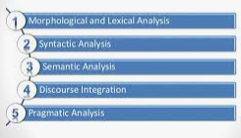
Steps used for NLU

Slide 27
Morphology analysis
Morphology is the arrangement and relationships of the smallest meaningful units in a language.
Eg:
Firehouse
Doghouse
runs

Slide 28
Lexical analysis
Lexicon of a language means the collection of words and phrases in a language.
Lexical analysis is dividing the whole chunk of text into paragraphs, sentences, and words.
friendful or beautyship → Lexically Incorrect
friendship and beautiful is correct → Lexically Correct

Slide 29
Syntactic analysis
Syntax analysis checks the text for meaningfulness comparing to the rules of formal
Eg:
“the girl go to the school “
Agra goes to the Poonam

Slide 30
Semantic analysis
It draws the exact meaning or the dictionary meaning from the text. The text is checked for meaningfulness.
Eg:Colourless blue idea

Slide 31
Discourse integeration
The meaning of any sentence depends upon the meaning of the sentence just before it
Eg:
she wanted it

Slide 32
Pragmatic analysis
how sentences are used in different situations how use affects the interpretation of sentence
Eg:
Close the window
She cuts banana with a pen

Slide 33
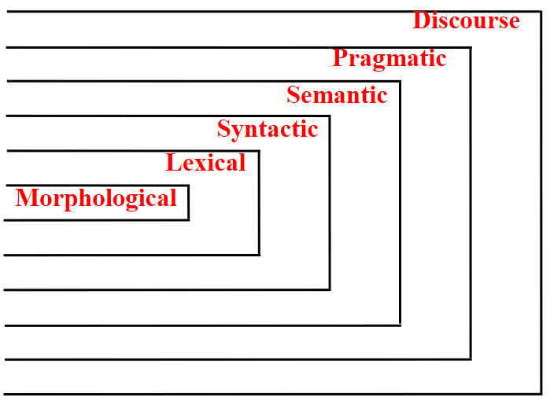
Introduction to Natural Language Processing
Different Levels of Language Analysis
-
Examples:
Syntax, Semantics, and Pragmatics
Green frogs have large noses.
Pragmatically wrong
Green ideas have large noses.
Semantics, and Pragmatics
Large have green ideas nose.
All three wrong
I are fond in animals (exercise)
My cat is studying Linguistics (exercise)
Spain is larger than China (exercise)

Slide 34
Why NLP is hard
Ambiguity
Eg:
Teacher strikes idle kids.
Sarah gave a bath to her dog wearing a pink t-shirt.
RBI raises interest rates or RBI raises, interest rates.

Slide 35
Ambiguities at all level
Structural Ambiguities
The professor said on Monday he would give an exam
Visiting relatives can be nuisance. (two meanings)
Lexical Ambiguities:
I saw bats

Slide 36
Contd..
Non Standard english
don’t follow any rules
Eg: gm, gudnit etc.
Segmentation issues
Eg The old city-bus stop
Idioms
Eg:
dark horse
lose face

Slide 37

World knowledge
Eg:
Mary and Sue are sisters.
Mary and Sue are mothers.
Tricky entity names
Let it be was recorded.
Where is a bug’s life playing?

Slide 38
Some of the tasks in NLP
Sentence segmentation
It breaks the paragraph into separate sentences.
Eg:Independence Day is one of the important festivals for every Indian citizen. It is celebrated on the 15th of August each year ever since India got independence from the British rule. The day celebrates independence in the true sense.
"Independence Day is one of the important festivals for every Indian citizen."
"It is celebrated on the 15th of August each year ever since India got independence from the British rule."
"This day celebrates independence in the true sense."

Slide 39
Contd..
Tokeniztion
splits longer strings of text into smaller pieces, or tokens.
Eg:JavaTpoint offers Corporate Training, Summer Training, Online Training, and Winter Training.
"JavaTpoint", "offers", "Corporate", "Training", "Summer", "Training", "Online", "Training", "and", "Winter", "Training", "."
Lemmatization
capture canonical forms based on a word's lemma.
Eg:better → good

Slide 40
Contd..
Stemming
process of eliminating affixes (suffixed, prefixes, infixes, circumfixes) from a word in order to obtain a word stem.
eg. running → run
Stop Words
contribute little to overall meaning
Eg:He is a good boy.

Slide 41
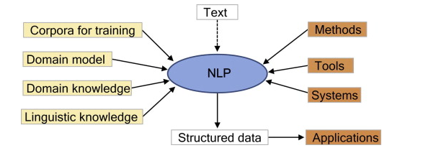
Schematic representation NLP

Slide 42
Representations and Understanding

Slide 43

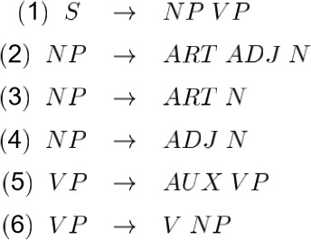
Syntactic representations of language
Most syntactic representations of language are based on the notion of context-free grammars
CFGs represent sentence structure in terms of what phrases are subparts of other phrases.
Often presented in a tree form

Slide 44
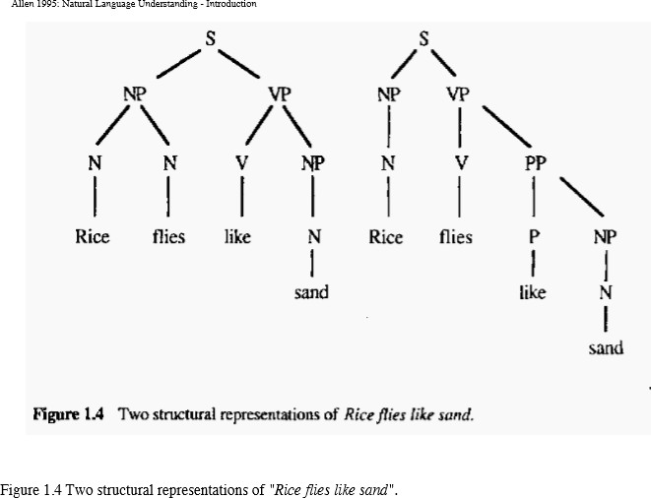
Representations and Understanding
CFG Rules
S -> NP VP
NP -> N N
NP -> N
VP -> V NP
VP -> V PP
PP -> P NP
Lexicon
Rice : N
Flies : N, V
Like : V, P Sand : N
NP – Noun Phrases
VP – Verb Phrases
PP – Prepositional Phrases

Slide 45
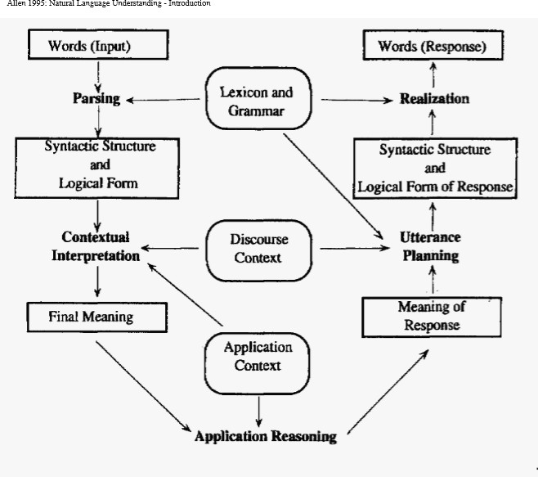
The Organization of Natural Language Processing Systems
Natural Language Understanding
Natural Language Generation

Slide 46
Evaluating Language Understanding Systems
What metrics to use?
How to deal with complex outputs like translations?
Are the human judgments measuring something real? reliable?
Is the sample of texts sufﬁciently representative?
How reliable or certain are the results?

Slide 47
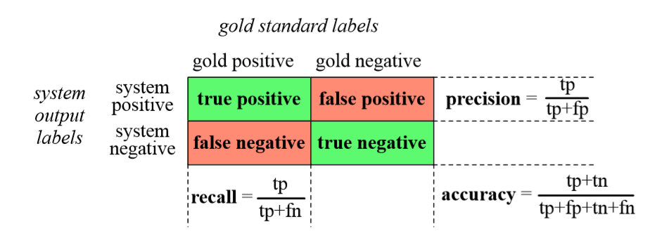
Contingency Table

Slide 48
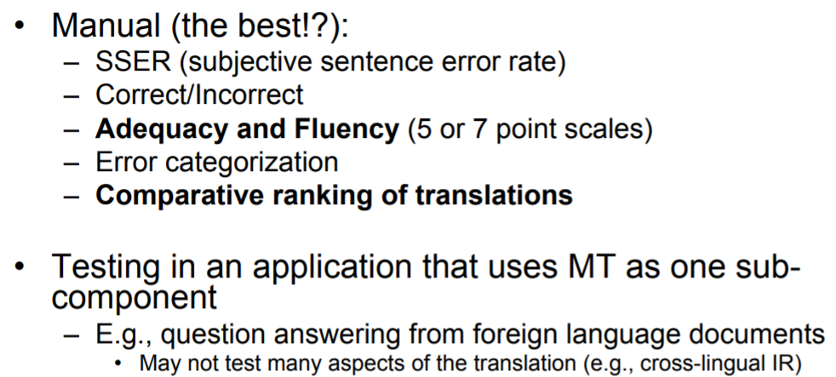
Some other evaluation measures

Slide 49
NLP Tools
Some commercial tools
IBM Watson | A pioneer AI platform for businesses
Google Cloud NLP API | Google technology applied to NLP
Amazon Comprehend | An AWS service to get insights from text
Open Source Tools
Stanford Core NLP is a popular Java library built and maintained by Stanford University.
SpaCy - One of the newest open-source Natural Language Processing with Python libraries
Gensim is a highly specialized Python library that largely deals with topic modeling tasks using algorithms like Latent Dirichlet Allocation (LDA)
Natural Language Toolkit (NLTK) is the most popular Python library
Generative Pre-trained Transformer (GPT) is an autoregressive language model released recently by Open AI, pre-trained on (billions of parameters). It is autocompleting program and is used mainly for predicting text
AllenNLP: Powerful tool for prototyping with good text processing capabilities. Automates some of the tasks which are essential for almost every deep learning model. It provides a lot of modules like Seq2VecEncoder, Seq2SeqEncoder.
Berkeley Neural Parser (Python). It is a high-accuracy parser with models for 11 languages. It cracks the syntactic structure of sentences into nested sub phrases. This tool enables the easy extraction of information from syntactic constructs

Slide 50
NLTK installation
The Natural Language Toolkit (NLTK) is a platform used for building programs for text analysis.
Open Anaconda terminal, run
pip install nltk.
Anaconda and Jupiter are best and popular data science tools
In Jupyter, the console commands can be executed by the ‘!’ sign before the command within the cell.
! pip install nltk
NLTK book
NLTK discussion forum
https://www.nltk.org/install.html

Slide 51
Good References
https://emerj.com/partner-content/nlp-current-applications-and-future-possibilities/
https://venturebeat.com/2019/04/05/why-nlp-will-be-big-in-2019/
https://www.nltk.org/book/
https://www.coursera.org/learn/python-text-mining/home/week/1
https://openai.com/api/
https://analyticssteps.com/blogs/top-nlp-tools
https://web.stanford.edu/~jurafsky/NLPCourseraSlides.html
https://www.cstr.ed.ac.uk/emasters/course/natural_lang.html
https://web.stanford.edu/class/cs224u/2016/materials/cs224u-2016-intro.pdf
https://www.mygreatlearning.com/blog/trending-natural-language-processing-applications/

Slide 52
Thank You… ☺
Q&A
Suggestions / Feedback

